Slide 1



SAP-Based Global Superstore Dashboard
-Akshita Vijaybhai Parekh
-Harsh Parmar

Slide 2

Project Objectives
Problem Statement
Project Overview – Introduction
End Users
Wow Factor in Project
Modelling/Block Diagram/Flow of Project
Result/outcomes
Conclusion
Future Perspective
Video

Slide 3
Problem Statement
Large retail organizations struggle with real-time analysis of sales, profit, and customer trends across multiple regions.
Existing reporting methods are time-consuming and lack interactivity.
A need for a centralized, dynamic dashboard that enables quick decision-making.

Slide 4
Project overview - Introduction
This project focuses on leveraging kaggle data and Power BI to create a comprehensive dashboard for a global superstore.
The dashboard provides real-time insights into sales, profits, and customer trends.
The aim is to streamline data visualization and enhance operational efficiency.

Slide 5
End User
Business analysts tracking sales and profit margins.
Marketing teams analyzing customer trends and segmentations.
Supply chain managers monitoring inventory and regional performance.
Senior management for strategic decision-making

Slide 6
Wow Factor in Solution
Advanced Data Visualization: Interactive charts, filters, and heatmaps for in-depth analysis.
Real-time Insights: Dynamic reporting for up-to-date decision-making.
Region-wise Performance Analysis: Sales trends broken down by geography.
Customer Segmentation: Identification of high-value customers and purchasing behavior.

Slide 7
Modelling
Data Source: Kaggle Database containing global superstore sales data.
Data Processing: ETL (Extract, Transform, Load) process using SAP tools.
Data Visualization: Power BI dashboard integrating key metrics.
User Interaction: Filters and drill-down capabilities for detailed insights.

Slide 8
Result / Outcomes
Developed an interactive Power BI dashboard that provides actionable insights.
Enhanced data accessibility and visualization for faster decision-making.
Improved operational efficiency through automated reporting.
Identified key sales trends and profitable regions, aiding strategic planning.

Slide 9
Conclusion
The project successfully addressed the challenges of data visualization and business intelligence for the global superstore.
The dashboard provides a scalable solution for real-time analytics and decision-making.
Future enhancements could include AI-driven predictive analytics and deeper customer insights.

Slide 10
Future Perspective
Integration of AI/ML models for predictive sales and trend forecasting.
Expansion to include additional KPIs such as customer satisfaction scores.
Development of a mobile-friendly version for on-the-go analytics.
API integration with other enterprise tools for a seamless reporting ecosystem.

Slide 11
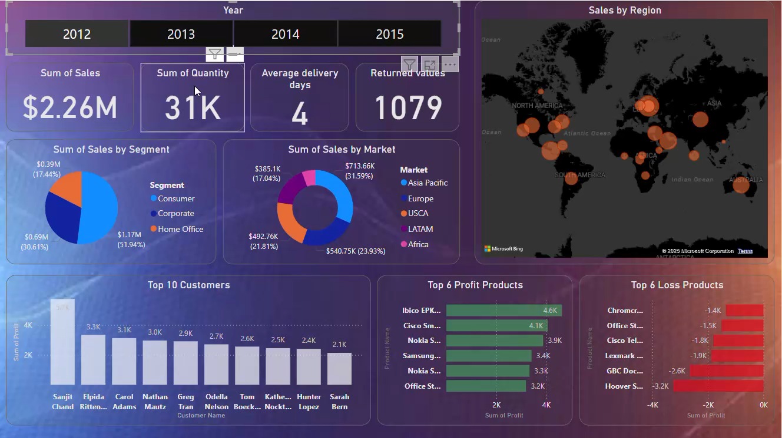
VISUAL:

Slide 12
Thank you...!
Notes:
‹#›

